Slide 1




SMART HOSPITAL MANAGEMENT SYSTEM WITH ASP.NET MVC
2025/04/14

Slide 2


PURPOSE
MANAGE HOSPITAL OPERATIONS DIGITALLY
Two main views:
Layout 1: Hospital info page
Layout 2: Dashboard for managing doctors & patients
2025/04/14

Slide 3






TECH STACK
ASP.NET MVC
ENTITY
FRAMEWORK
BOOTSTRAP
HTML/CSS
SQL SERVER
2025/04/14

Slide 4
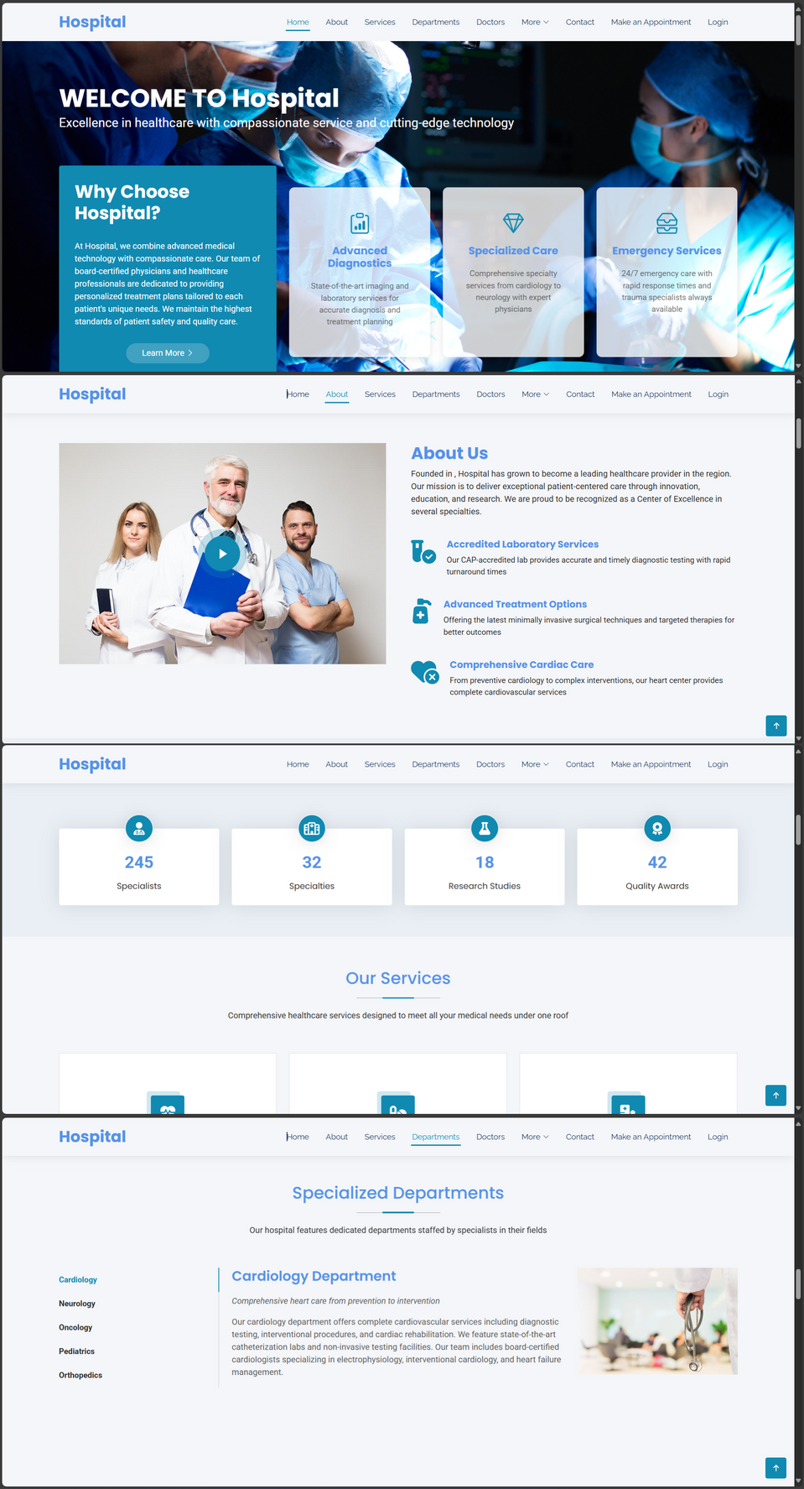

HOSPITAL INFO PAGE
OVERVIEW OF HOSPITAL DEPARTMENTS, SERVICES, AND CONTACT INFO
PUBLIC-FACING PAGE FOR VISITORS
2025/04/14

Slide 5
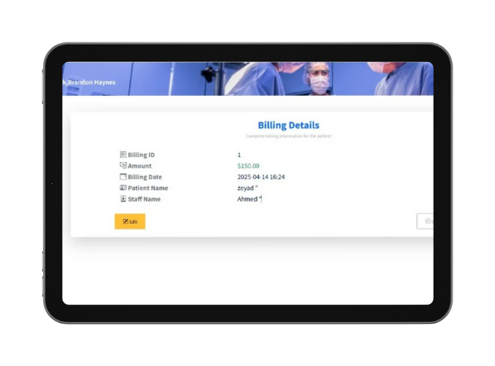
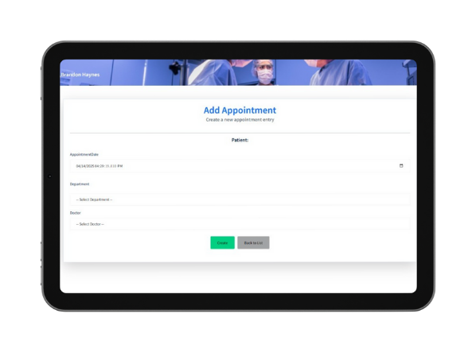
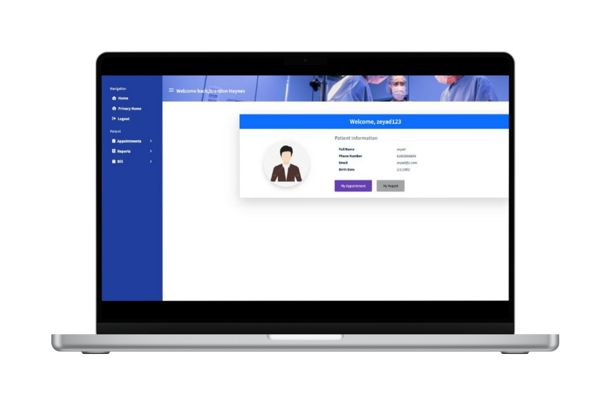

DASHBOARD
Admin dashboard for:
Adding, editing, deleting doctor and patient records
Managing appointments
Role-based access (Admin/Doctor)
2025/04/14

Slide 6


WORKFLOW
& FEATURES
Doctors:
Create, update profiles
Assigned to patients
Do medical report
Patients
Add appointments , schedule visits
2025/04/14

Slide 7
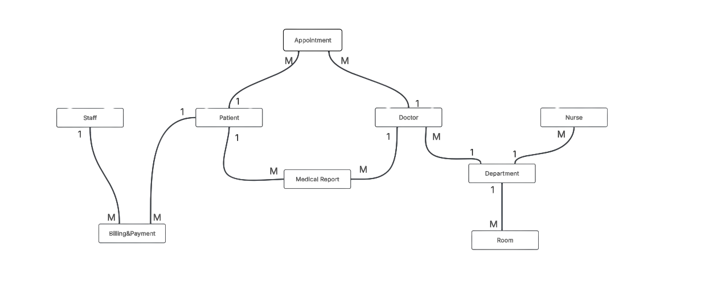
DATABASE DESIGN
2025/04/14

Slide 8

2025/04/14

Slide 9


THANK YOU
2025/04/14

